Slide 1
Jackson Hole and Teton County Resident Survey Towards Tourism
Results Analysis
April 2022

Slide 2
Survey Demographics

Slide 3
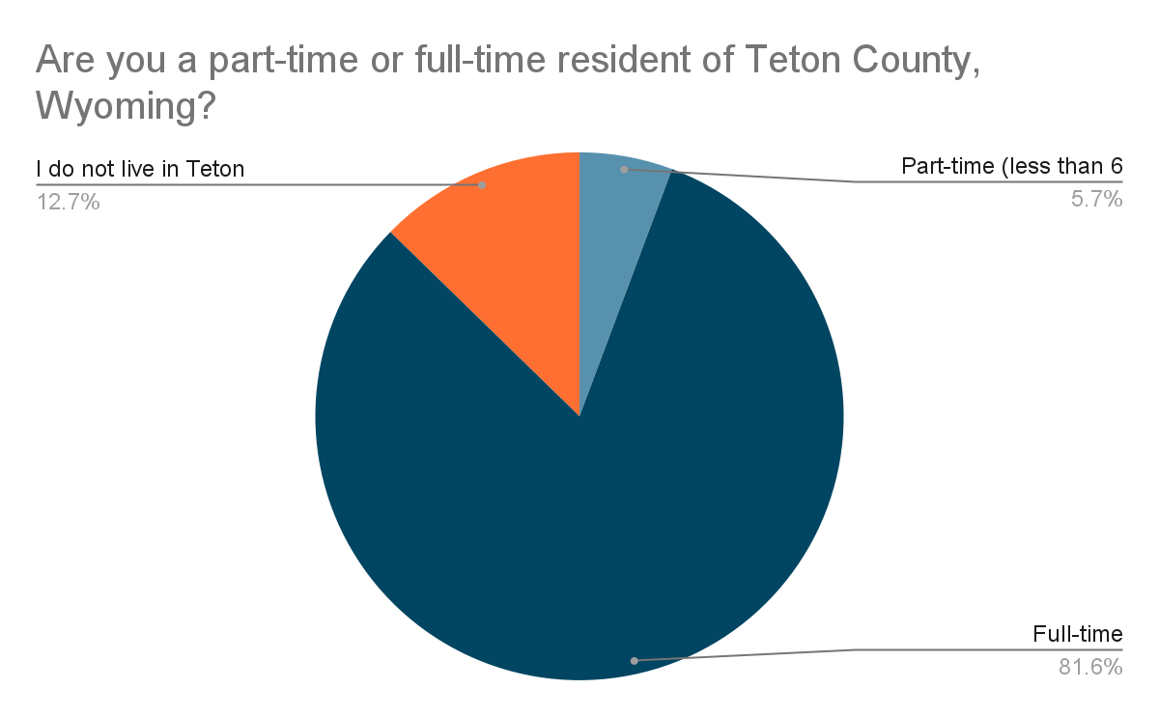
Residency
N=3,531

Slide 4
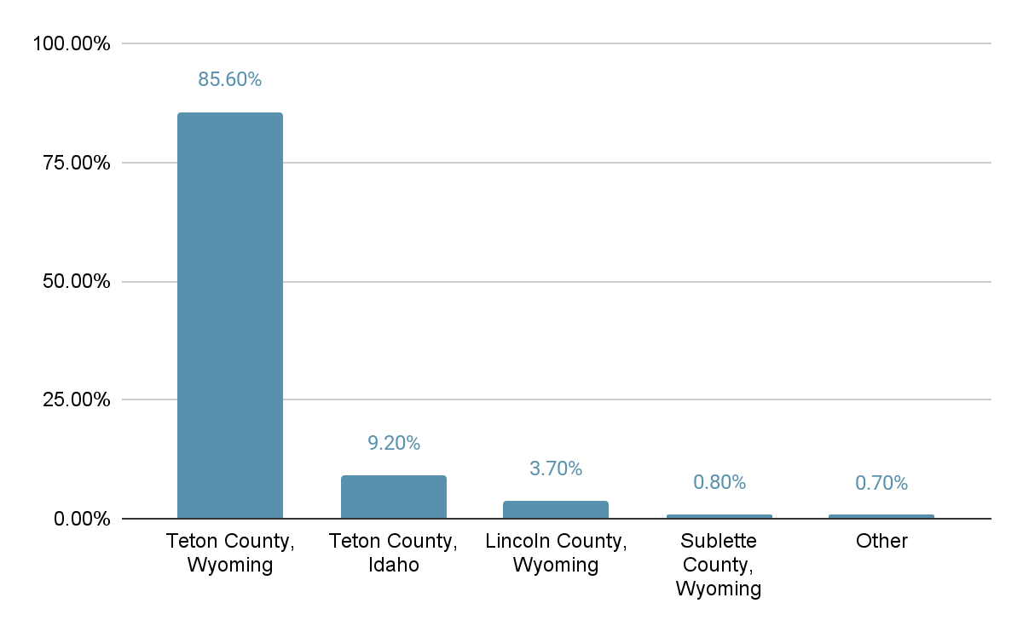
Residency
N=3,542

Slide 5
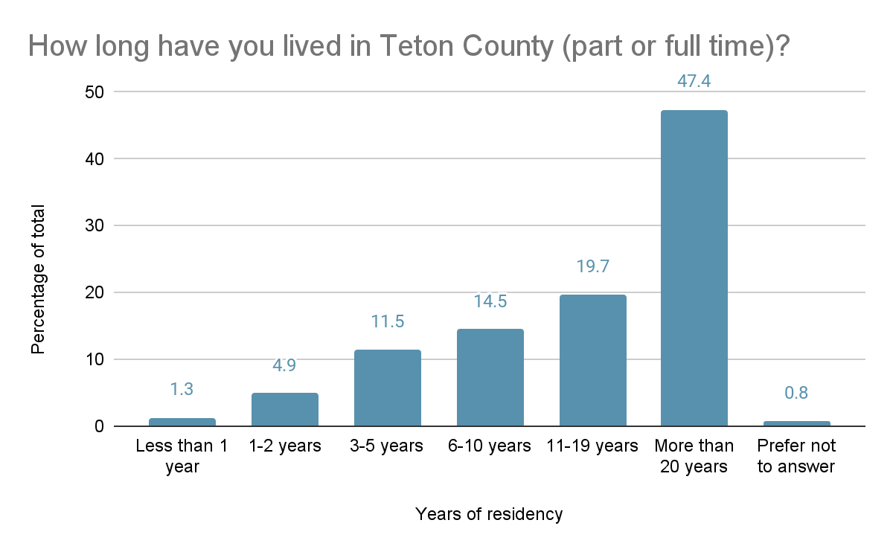
Length of residency in Teton County
N= 3,086

Slide 6
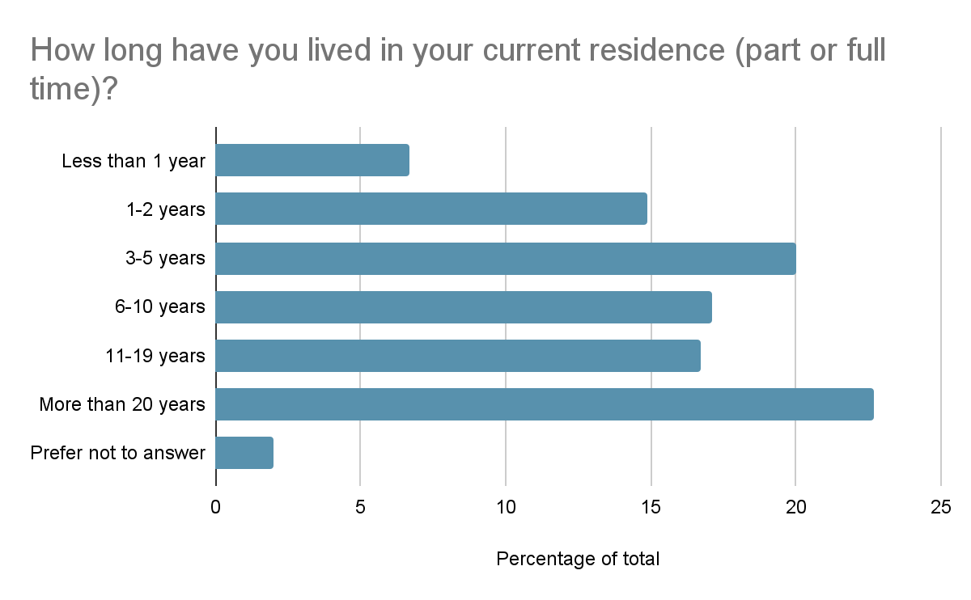
Time in current residence (non-Teton County residents)
N=450

Slide 7
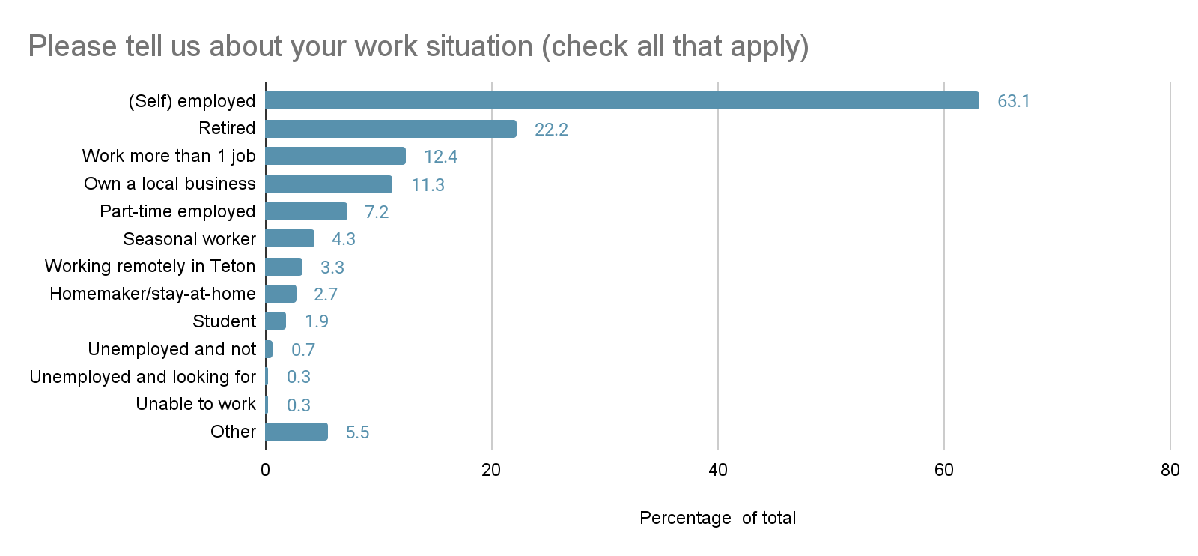
Work situation
N=3,506

Slide 8
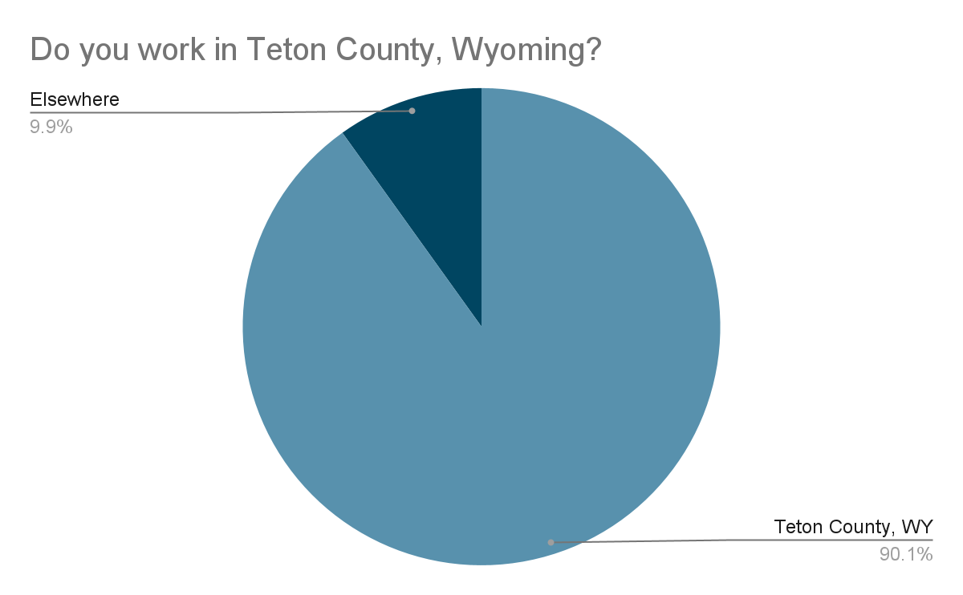
Location of work
N=2,608

Slide 9
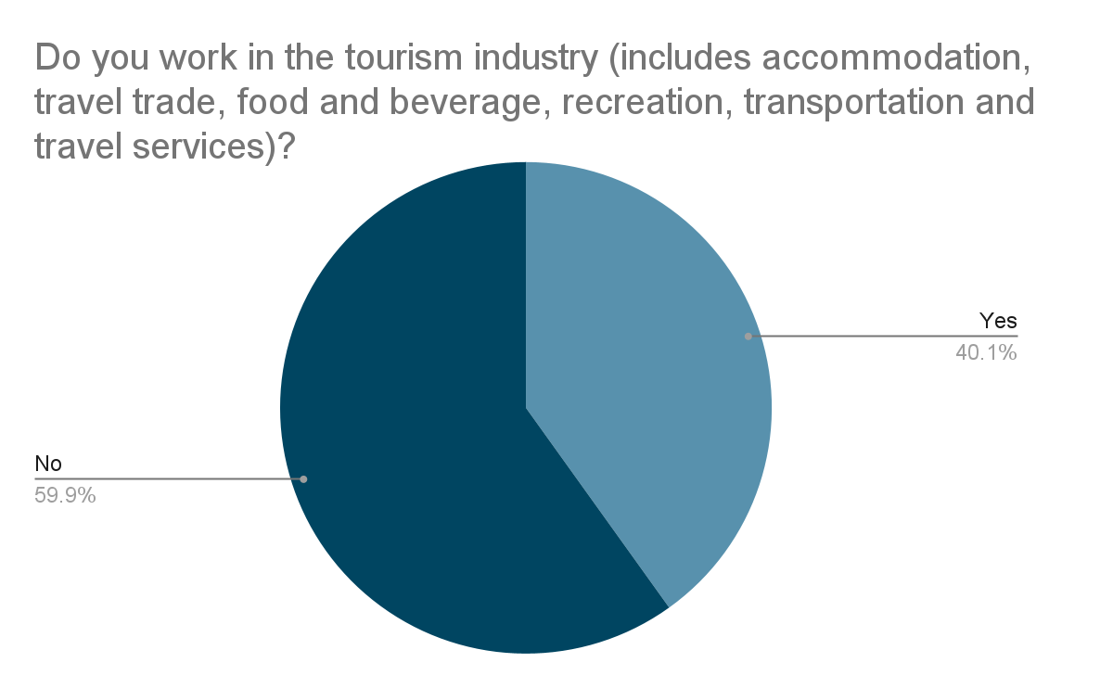
Employed in the tourism industry (of total employed)
N = 2,349

Slide 10
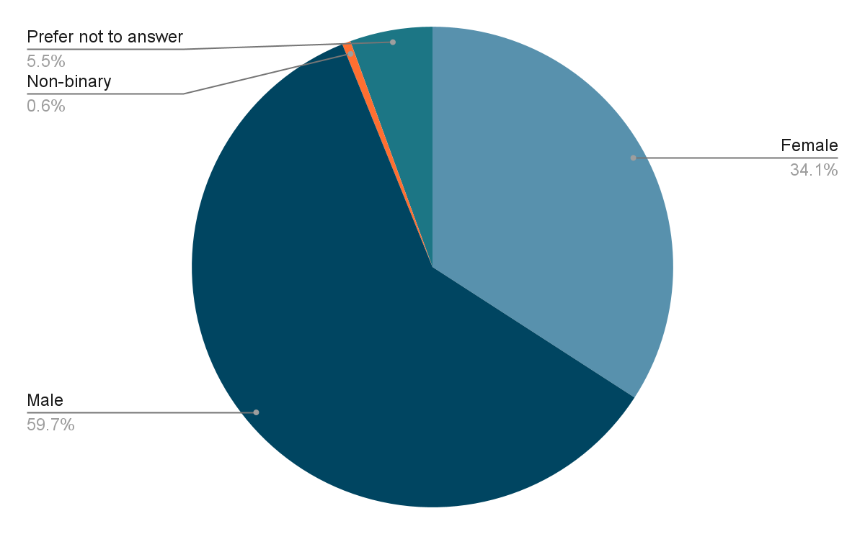
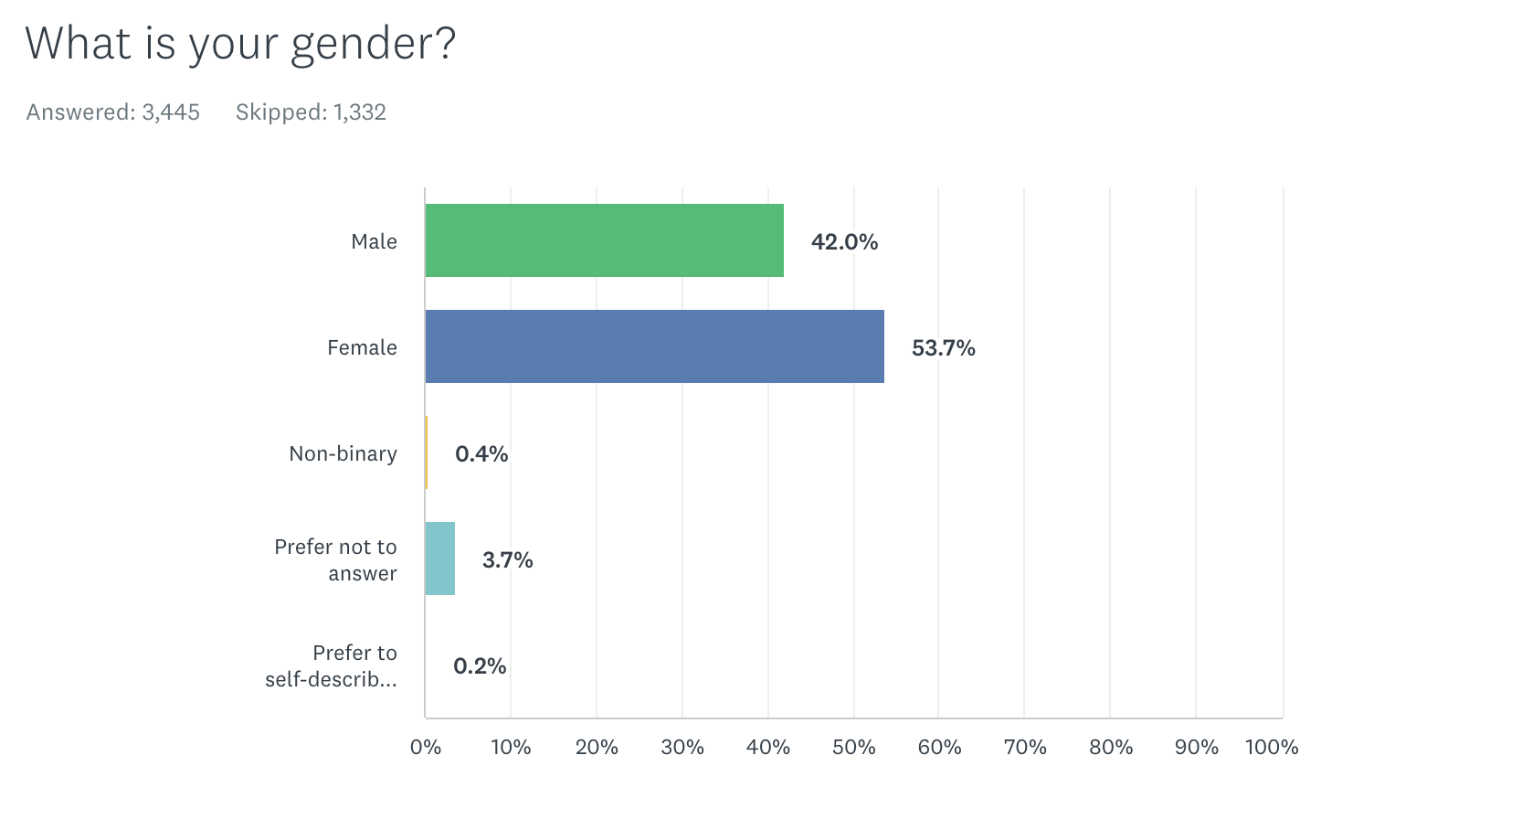
Gender
N=3,445

Slide 11
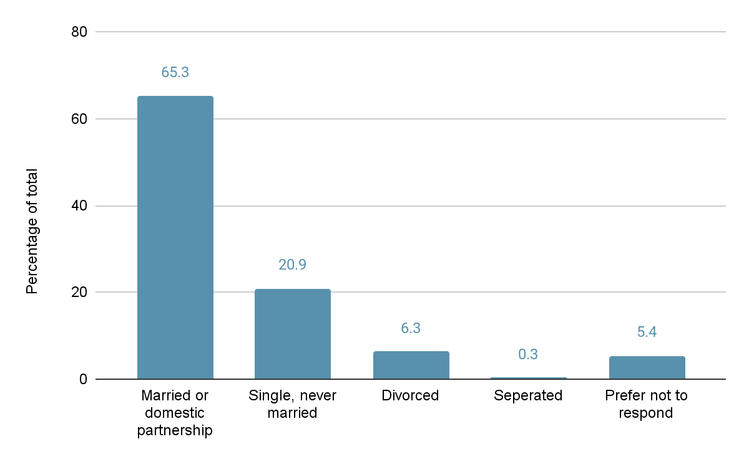
Marital status
N=3,443

Slide 12
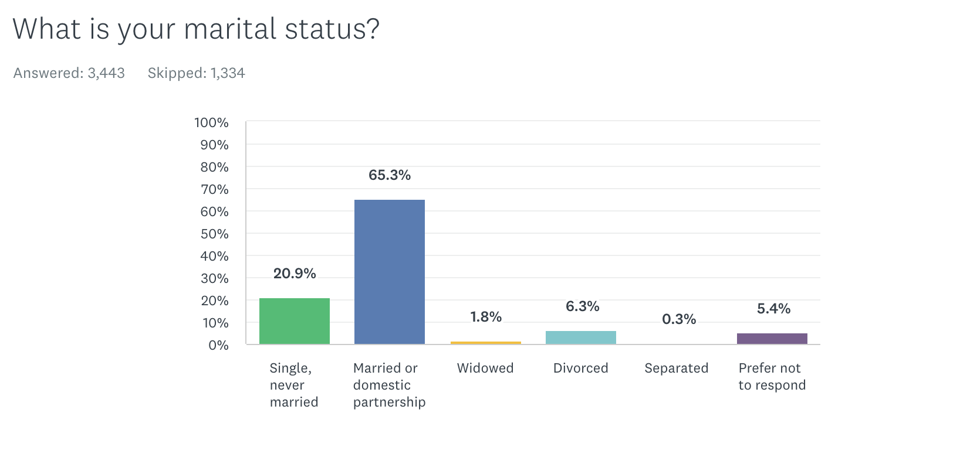
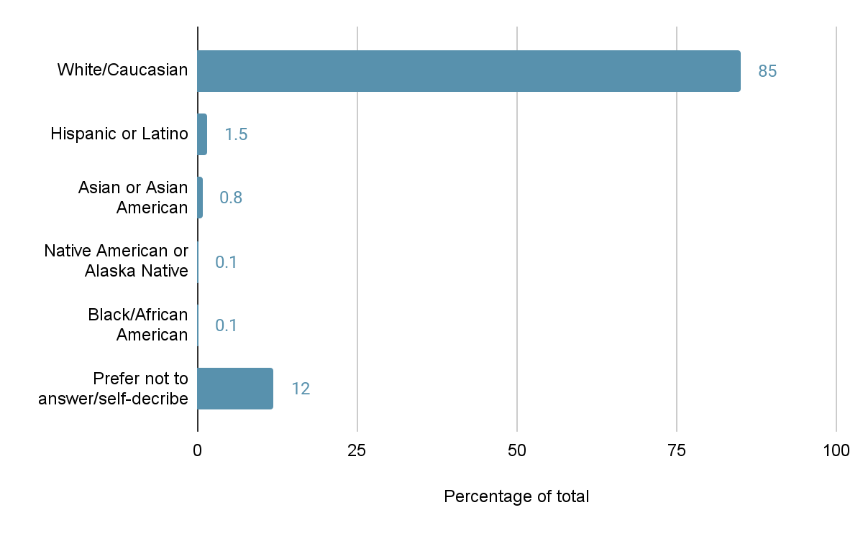
Ethnic heritage
N=3,442

Slide 13
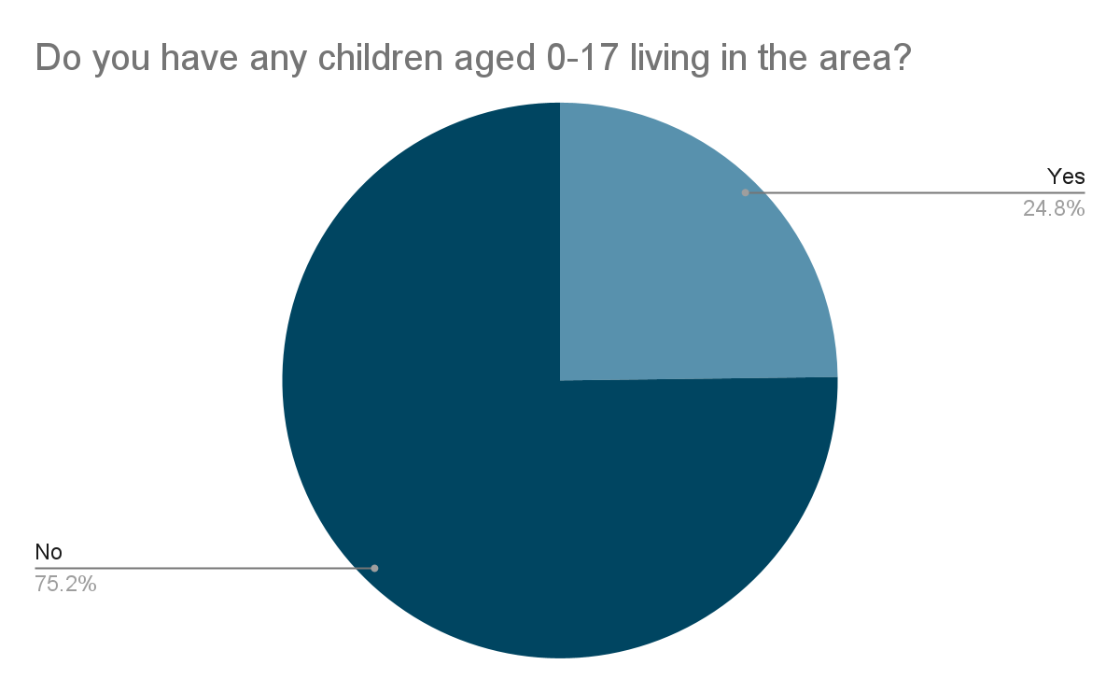
Respondent has children (0-17) living in the area
N=3,440

Slide 14
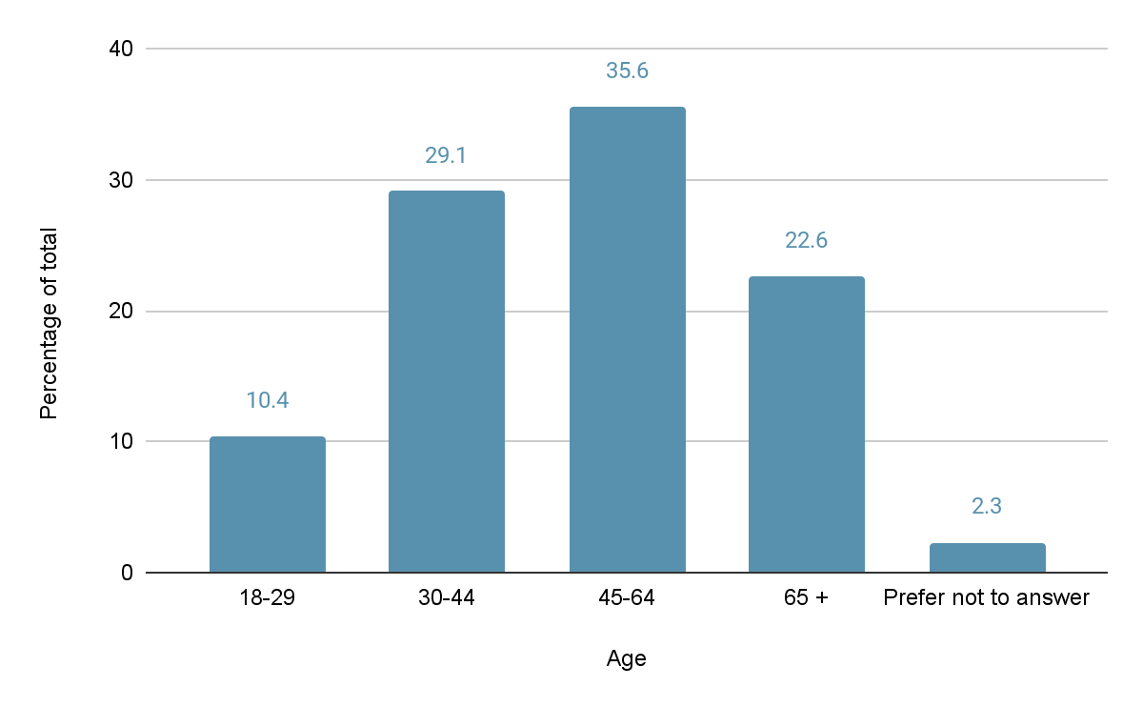
Age
N = 3,446

Slide 15
Survey Analysis
Key Questions

Slide 16
Overarching Sentiment

Slide 17
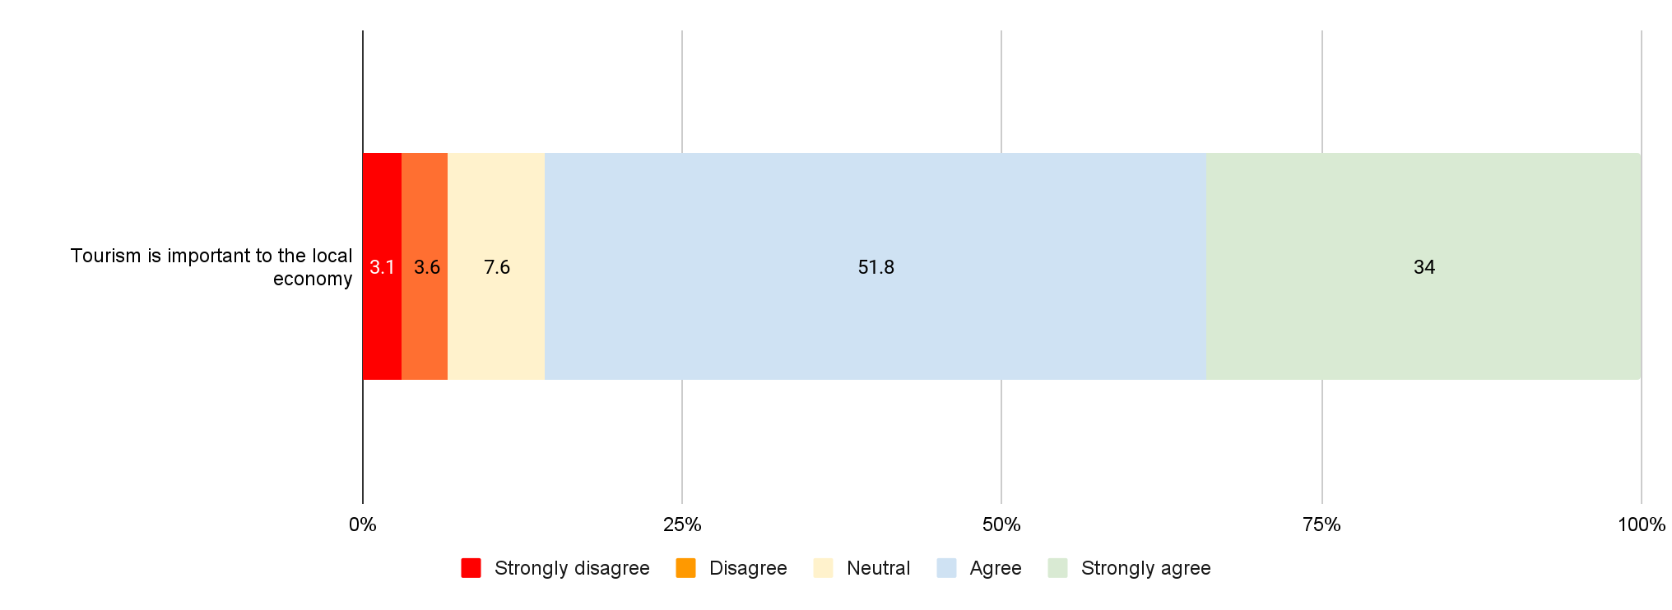
86% of respondents agree or strongly agree with the statement that tourism is important to the local economy
N=4,264

Slide 18
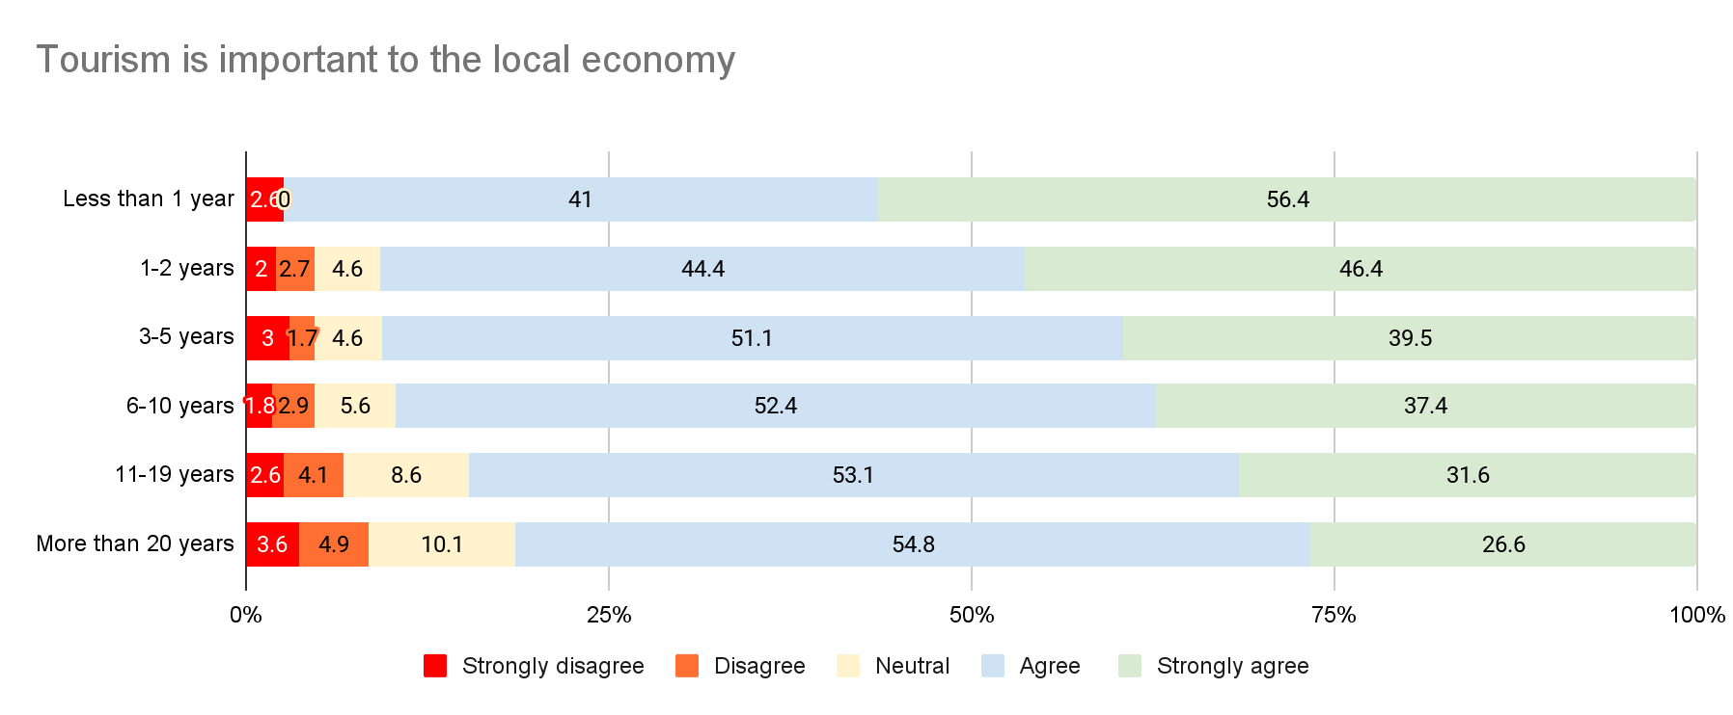
Respondents who live in the county for less years, are more likely to agree that tourism is very important for the county
N=3,060

Slide 19
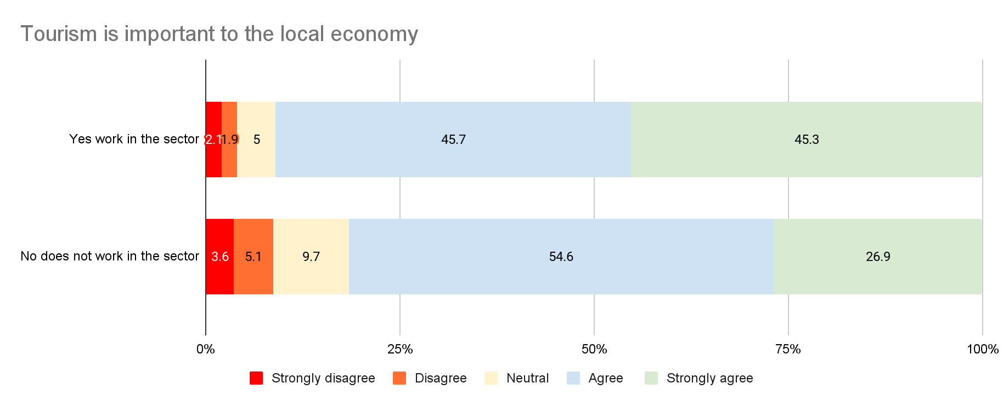
Those that work in the tourism industry are more likely to state that tourism is important to the local economy
N=2,346

Slide 20
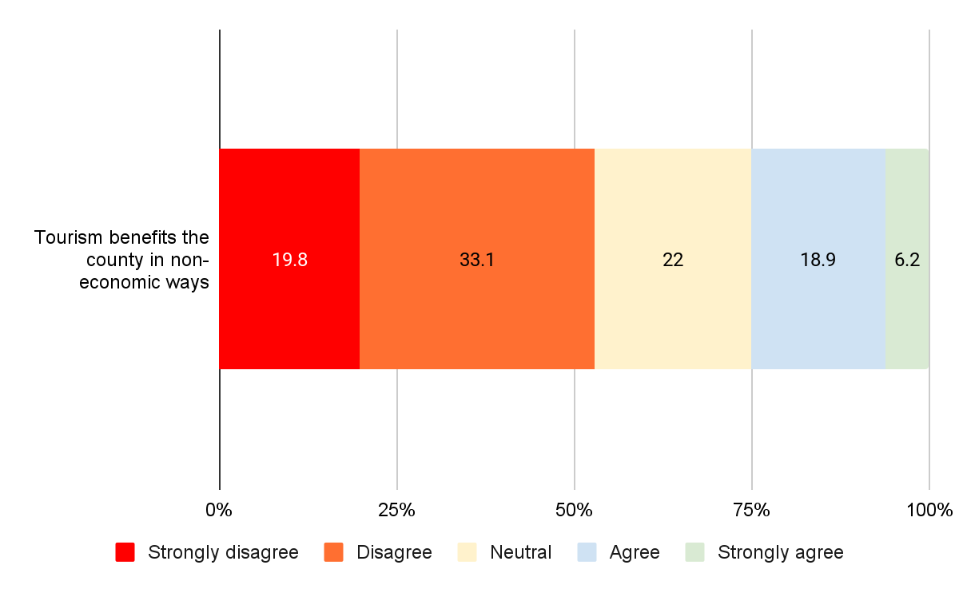
53% of respondents disagree or strongly disagree that tourism benefits the county in non-economic ways
N=4,259

Slide 21
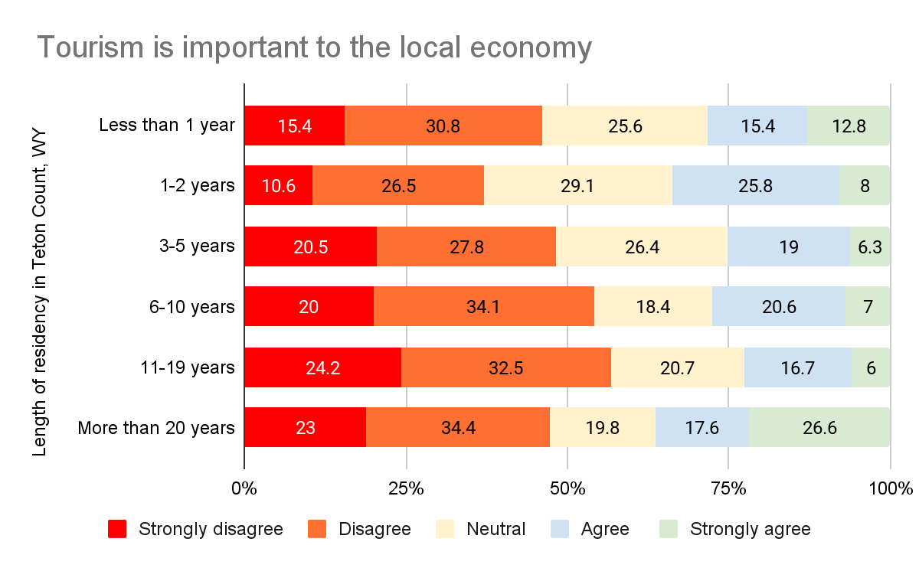
Respondents who live in the county less years are more likely to agree that tourism benefits them in non-economic ways
N=3,060

Slide 22
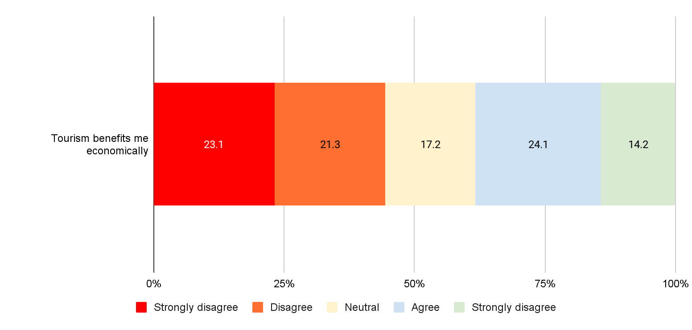
44% of respondents feel that tourism does not benefit them economically while 38% agrees it does
N=4,249

Slide 23
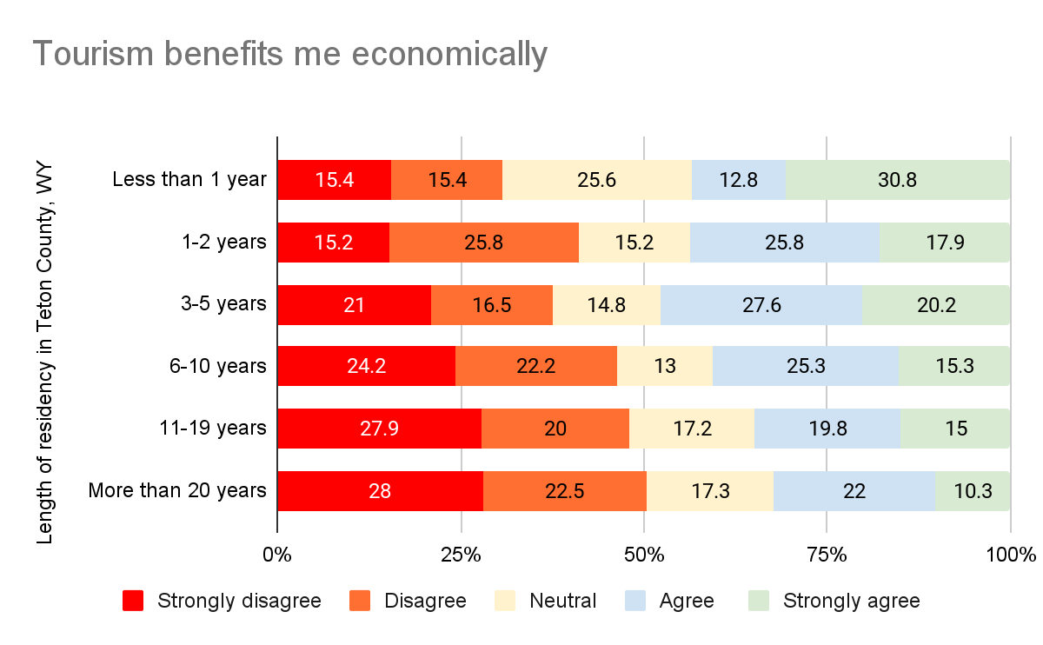
Respondents who have lived in the county longer, are less likely to state that tourism benefits them economically
N=3,060

Slide 24
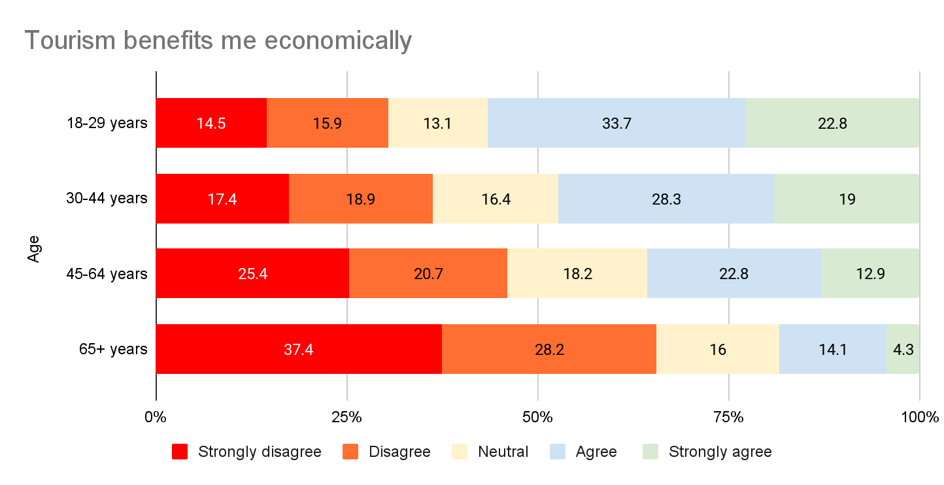
Younger people perceive more economic benefits from tourism than older people
N= 3,365

Slide 25
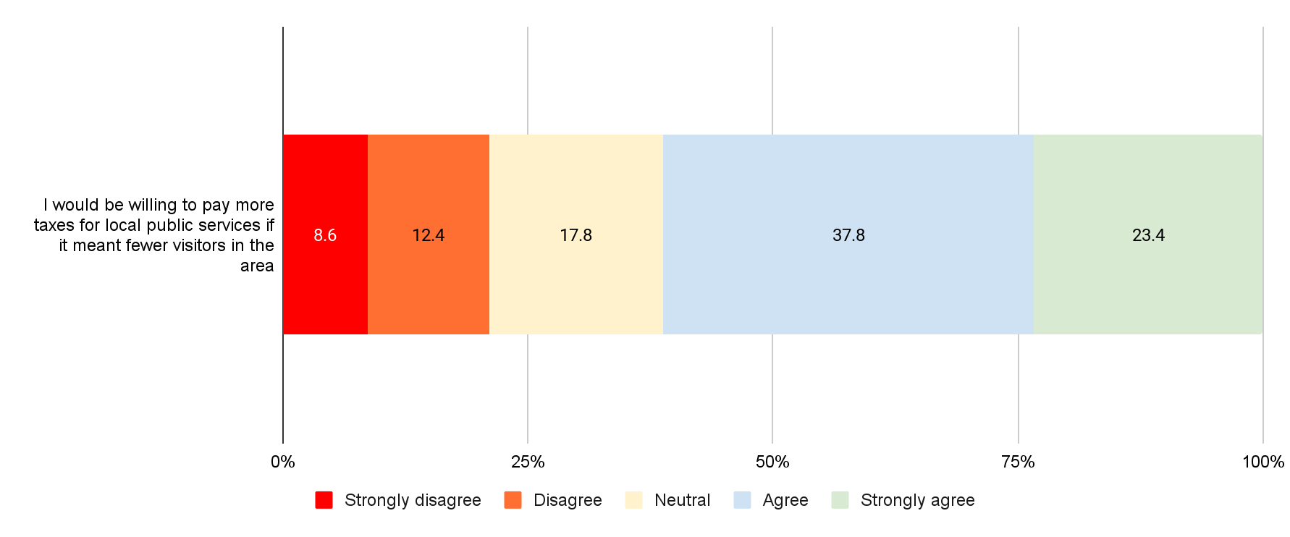
61% of respondents would be willing to pay more taxes if it meant fewer visitors in the area
N=4,260

Slide 26
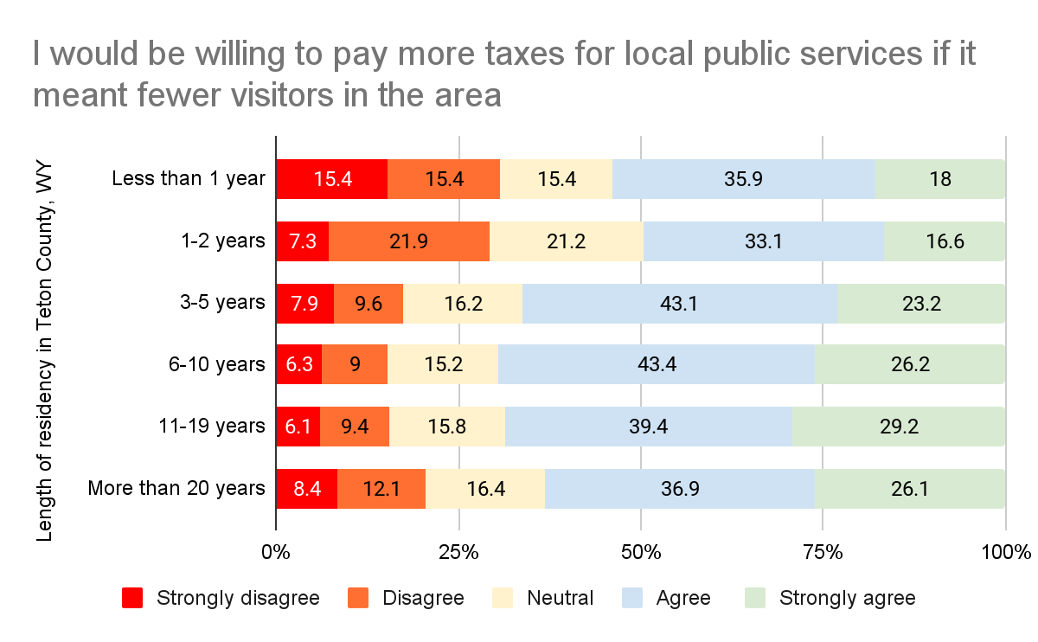
Respondents who have lived in the county between 3-20 years are more likely to be willing to pay more taxes in exchange for fewer visitors
N=3,060

Slide 27
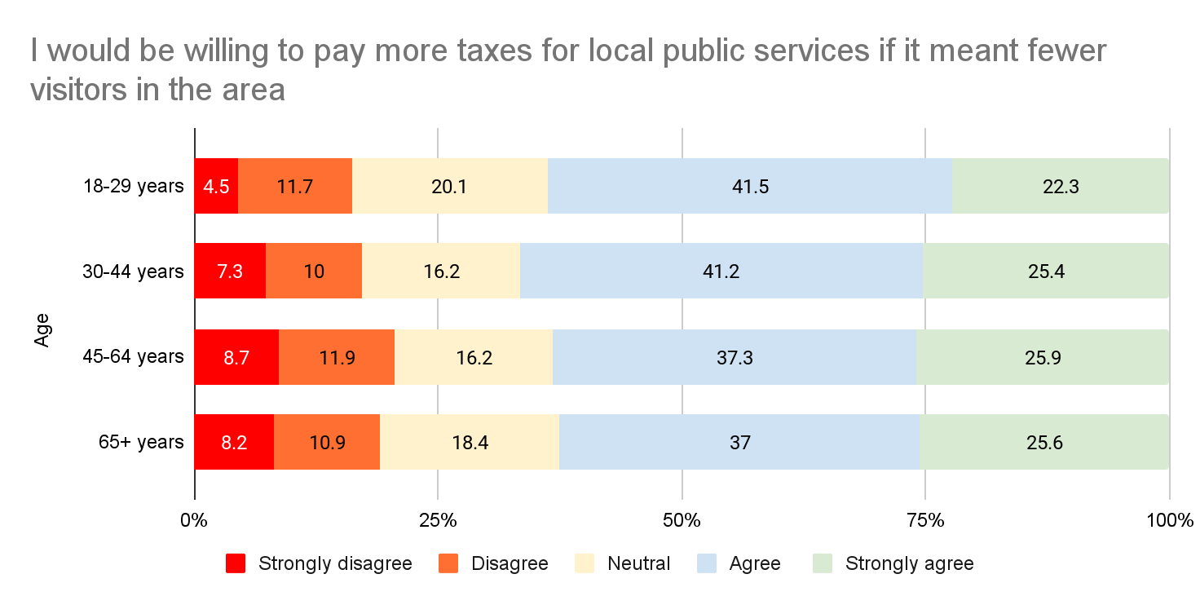
No significant difference in age groups’ willingness to pay pay more taxes if that means fewer visitors
N=3,365

Slide 28
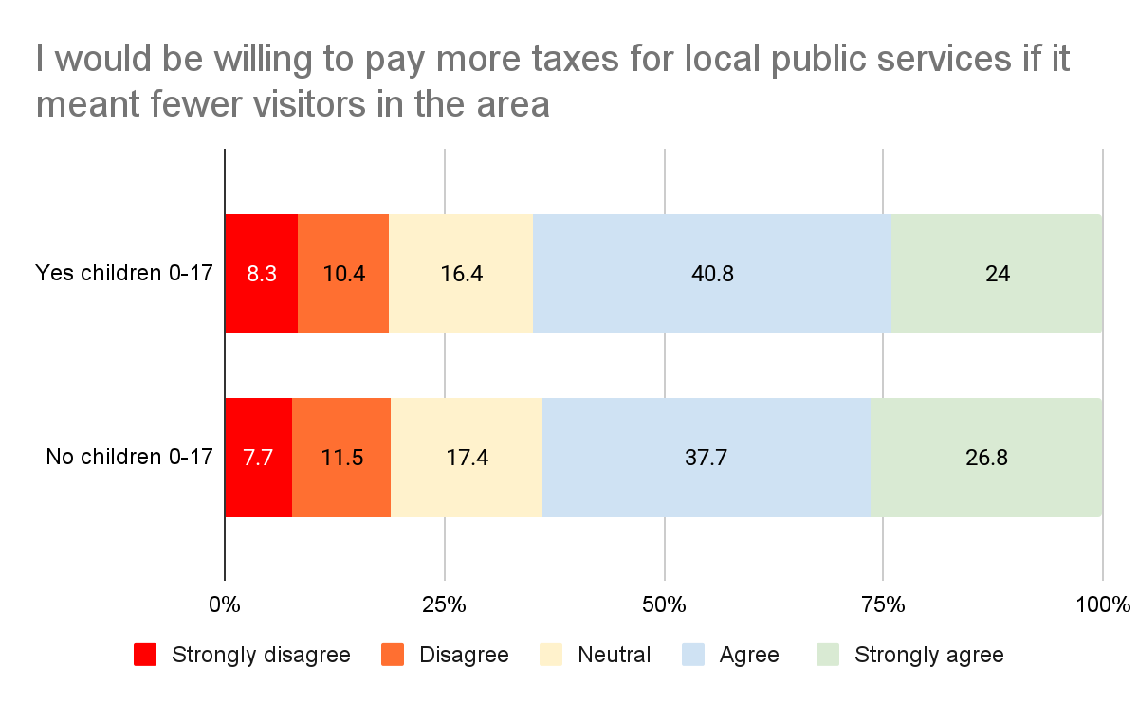
Respondents with children 0-17 years old are slightly less willing to pay more taxes in exchange for fewer visitors than those without children
N=3,437

Slide 29
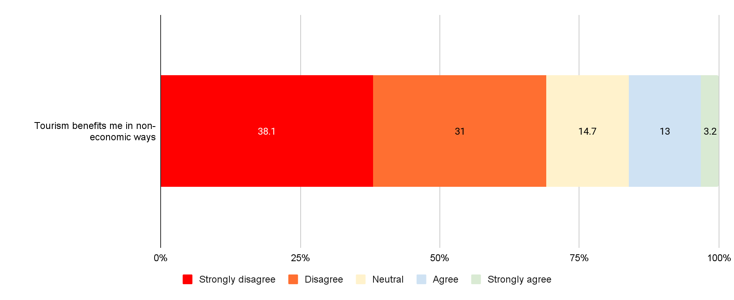
16% of respondents feel that tourism benefits them in a non-economic way
N=4,254

Slide 30
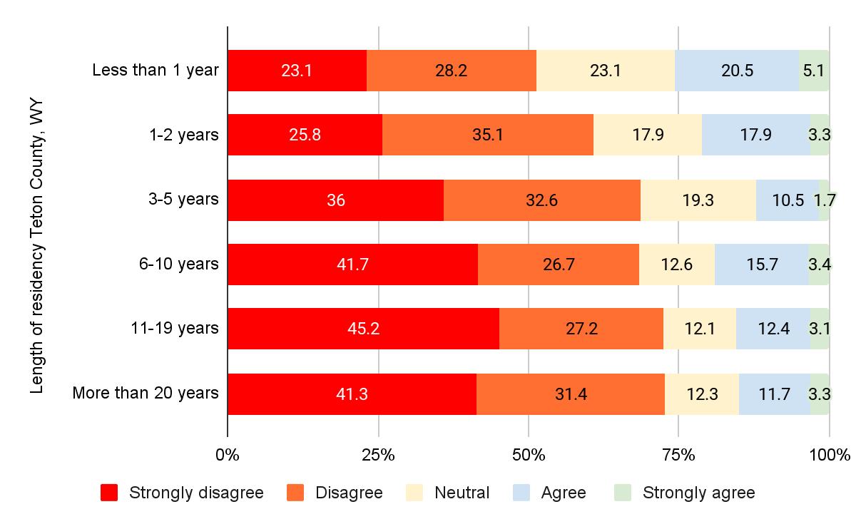
Long-time residents are less likely to feel that tourism benefits the county in non-economic ways
N=3,060

Slide 31
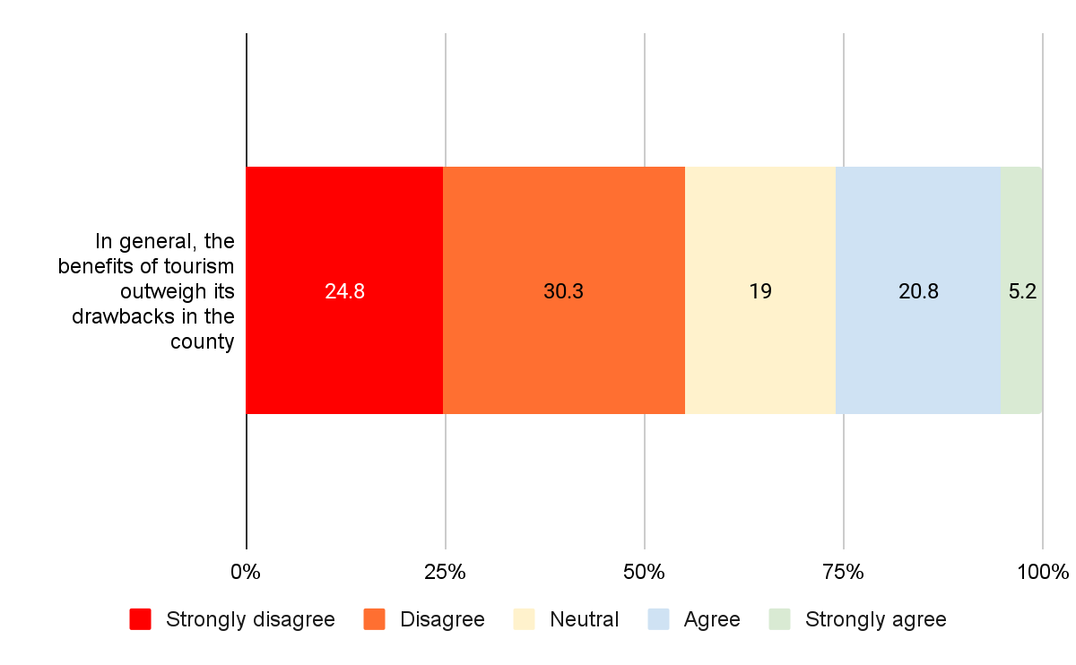
55% of respondents disagree or strongly disagree that the benefits from tourism in the county outweigh the drawbacks
N=4,266

Slide 32
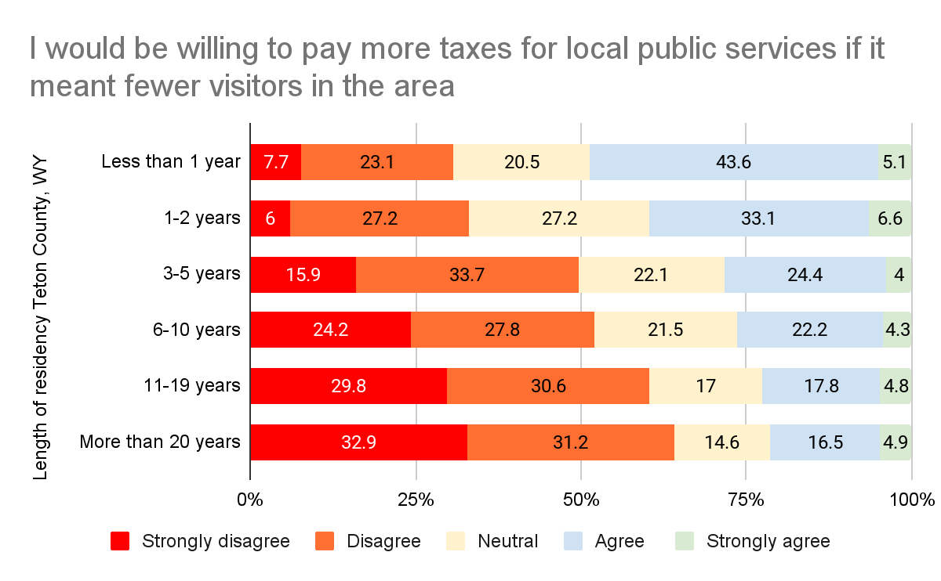
The longer respondents have lived in the county, the less likely they to state that the benefits of tourism outweigh the drawbacks
N=3,060

Slide 33
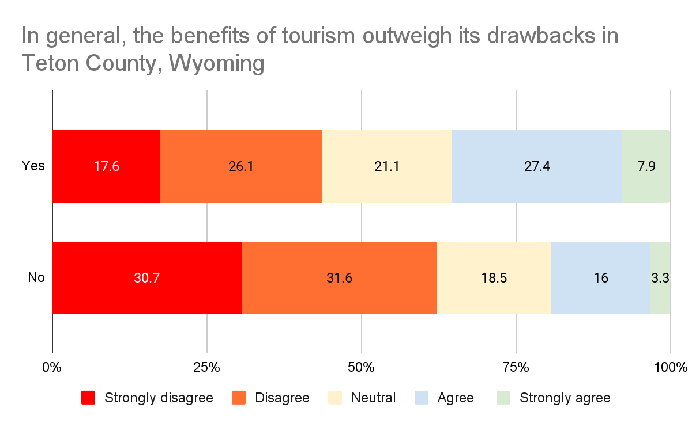
Those that work in the tourism industry are more likely to state that the benefits of tourism outweigh the drawbacks
N=2,346

Slide 34
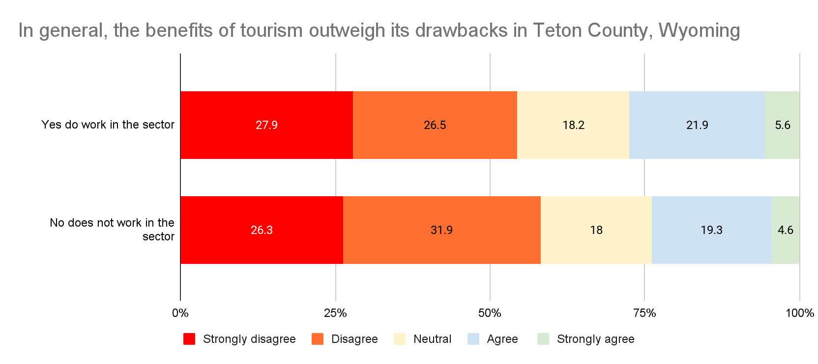
People with children 0-17 (27.5%) are more likely to see the benefits from tourism outweigh the drawbacks than respondents without (23.8%)
N=3,437

Slide 35
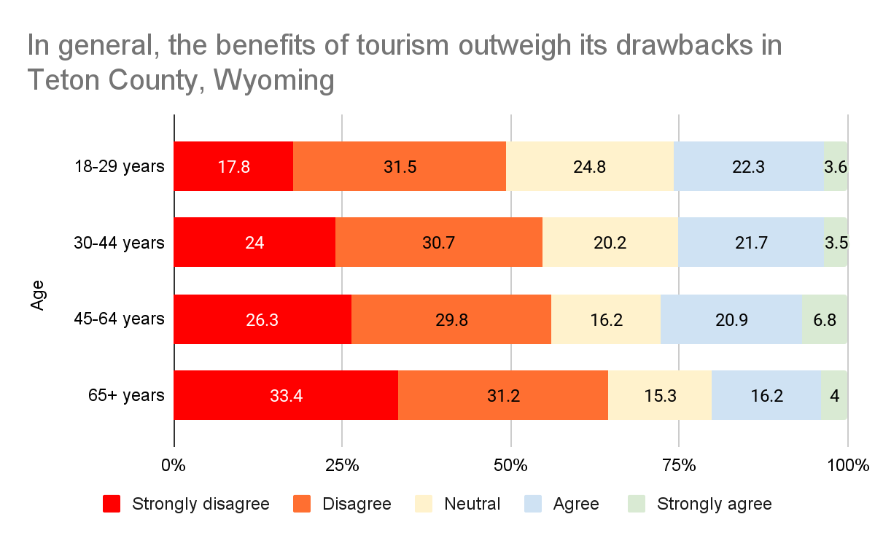
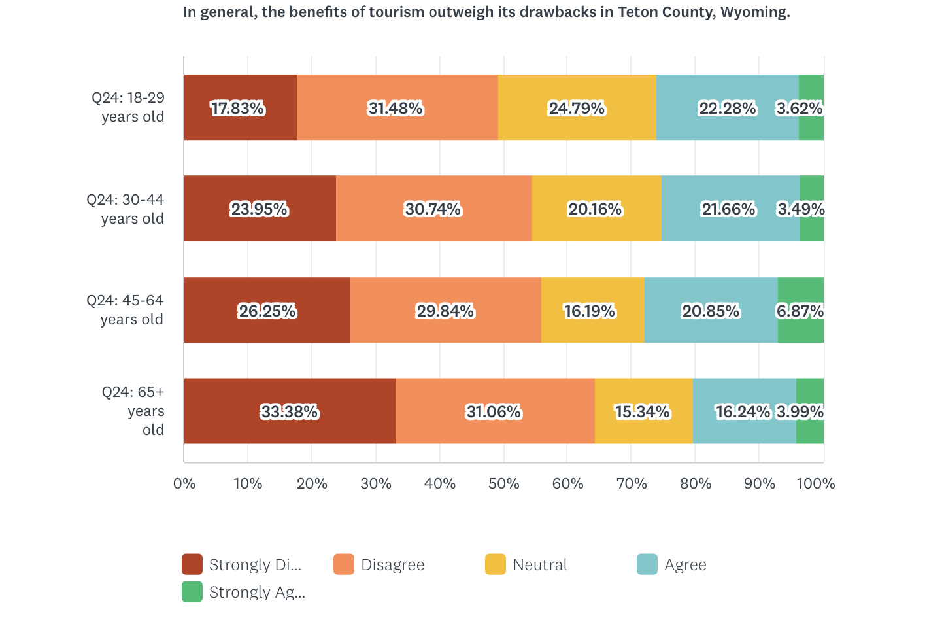
Older respondents more strongly disagree that the benefits from tourism outweigh the drawbacks in the county than younger respondents
N=3,365

Slide 36
Overall Satisfaction by Season

Slide 37
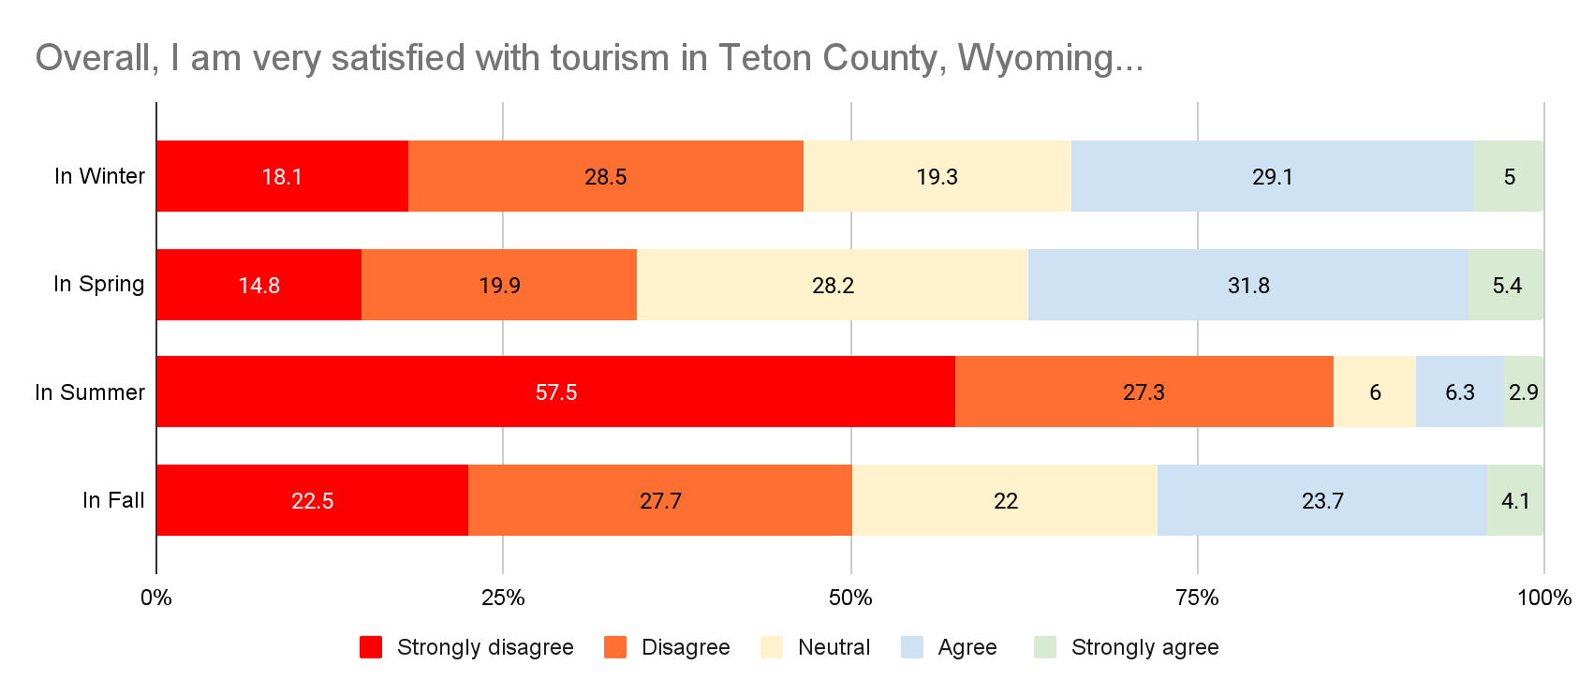
Respondents are least satisfied with tourism in summer followed by fall and winter
N=4,287

Slide 38
Tourism Infrastructural Development

Slide 39
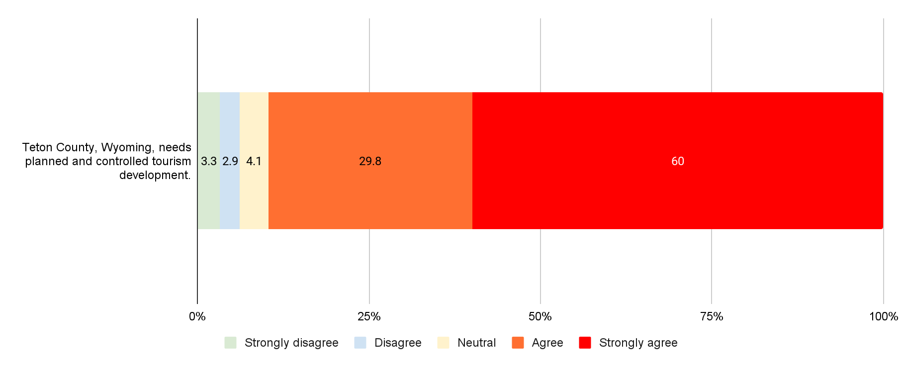
Almost 90% of respondents agree or strongly agree that the county needs planned and controlled tourism development
N=4,097

Slide 40
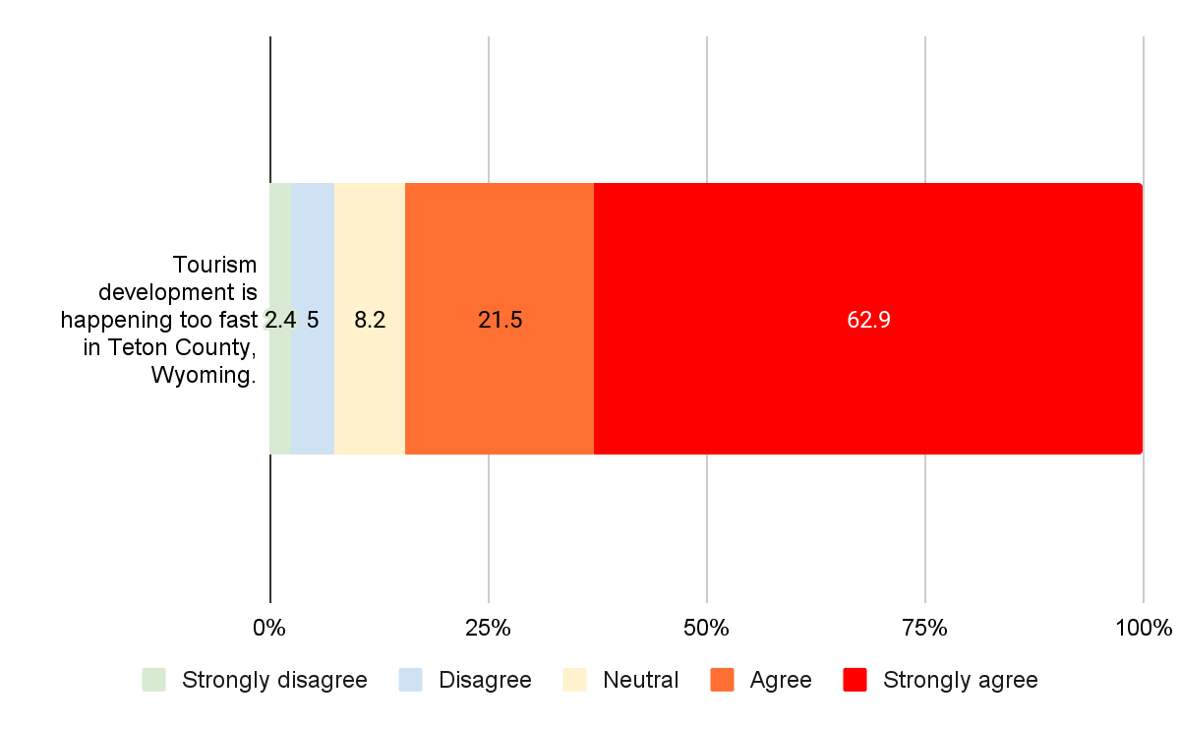
84% of respondents agree or strongly agree that tourism development is happening too fast
N=4,101

Slide 41
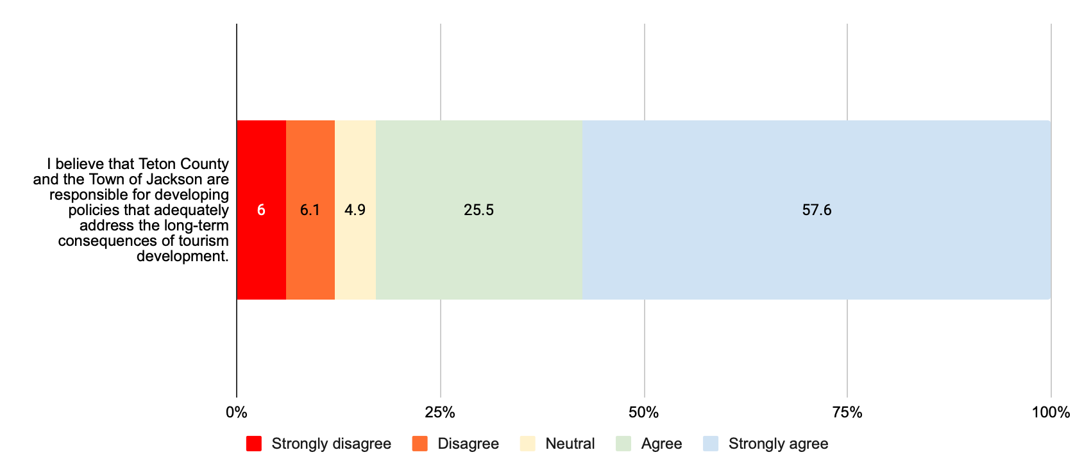
83% of respondents agree or strongly agree that the County and the Town are responsible for developing policies to address the long-term consequences of tourism development
N=4,095

Slide 42
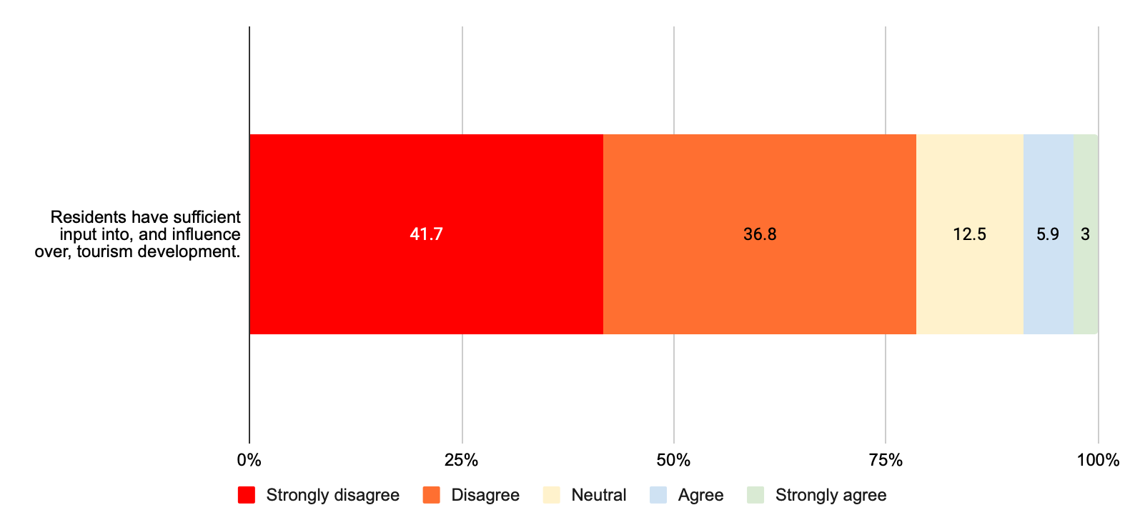
Just 9% of respondents agree or strongly agree that residents have sufficient input, and influence over, tourism development
N=4,100

Slide 43
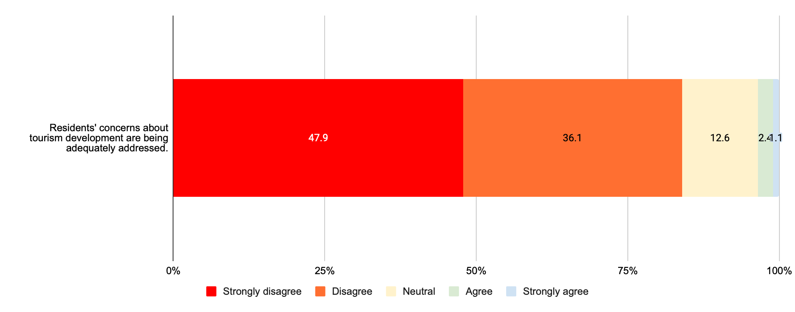
84% of respondents disagree or strongly disagree that residents’ concerns about tourism development are being adequately addressed
N=4,100

Slide 44
Quality of Life

Slide 45
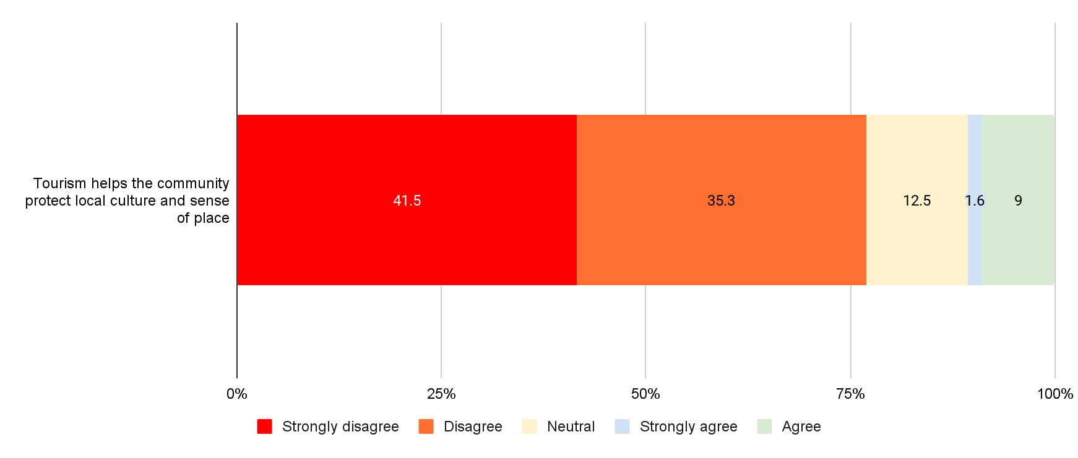
77% of respondents disagree or strongly disagree with the statement that tourism helps protect local culture and sense of place
N=3,892

Slide 46
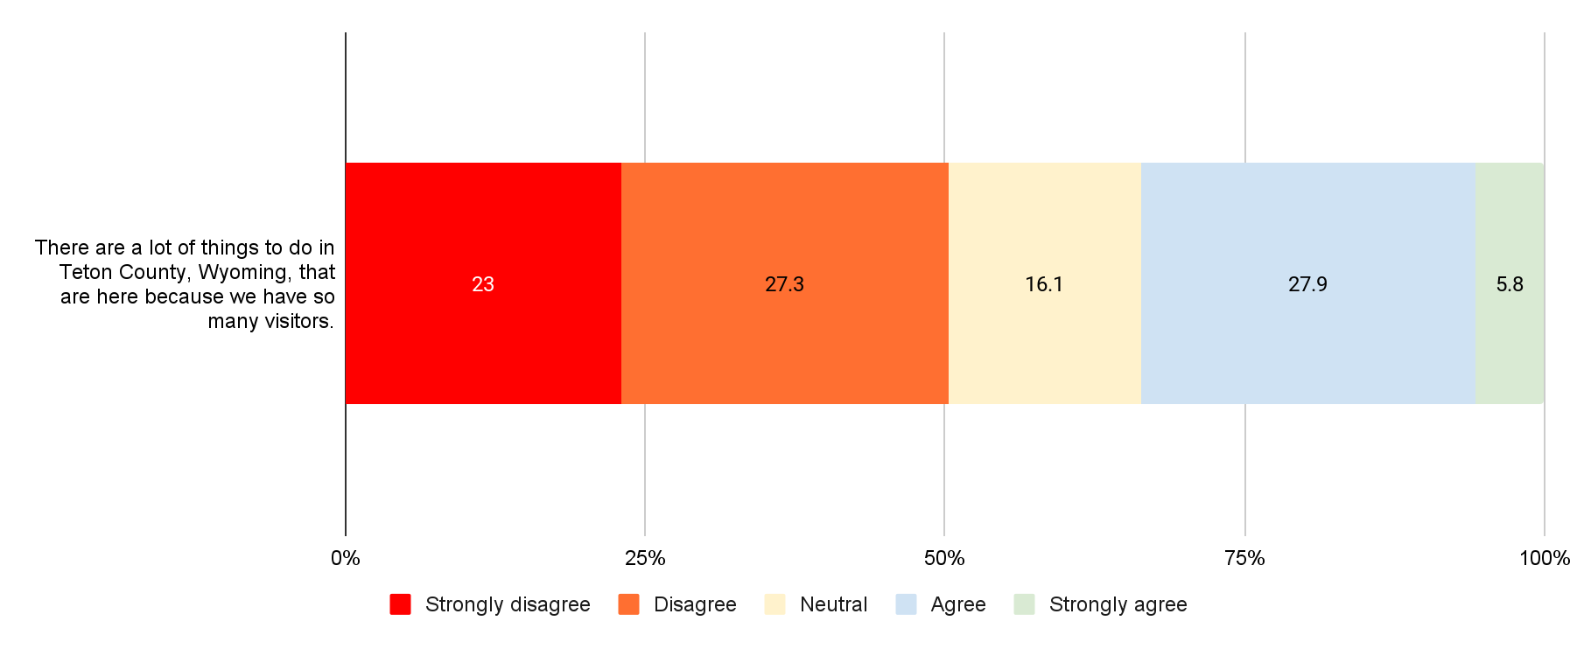
34% of respondents agree or strongly agree that the many things to do in the county are there since there are so many visitors
N=3,894

Slide 47
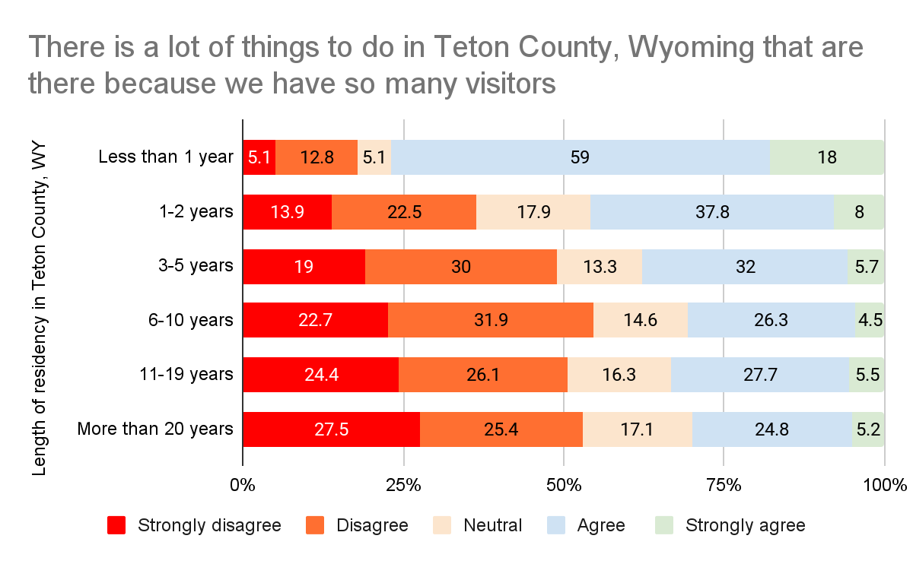
People who live in the county for less years, are more likely to agree to the statement that because of tourism there are a lot of things to do
N=3,061

Slide 48
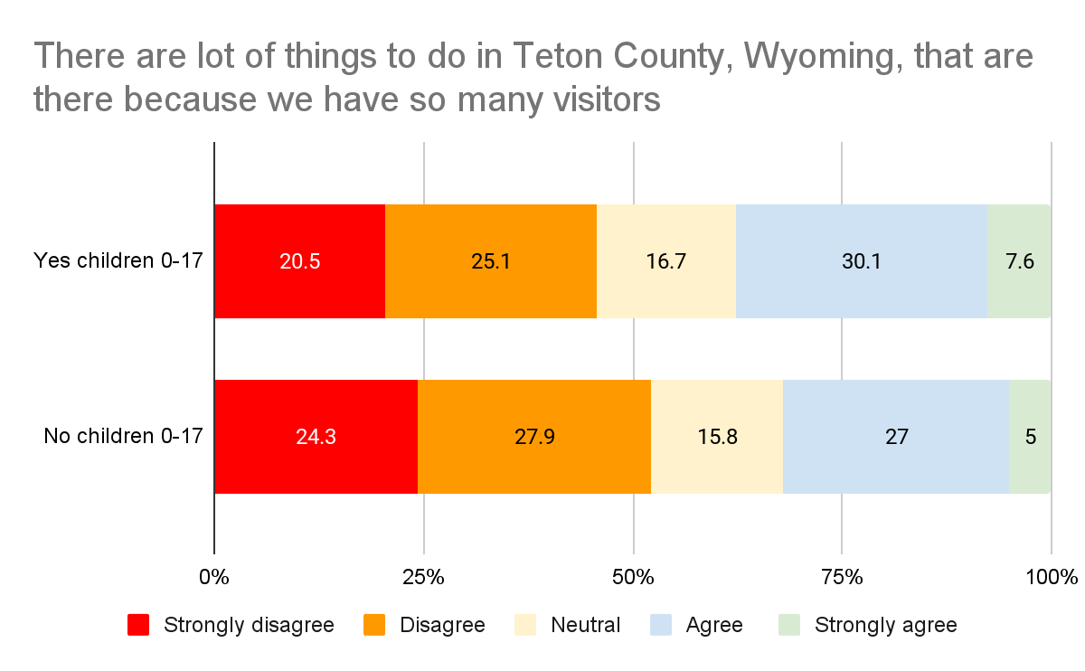
People with children 0-17 (38%), are more likely to agree or strongly agree that there are a lot of things to do in the county since there are so many visitors, than respondents without children (32%)
N=3,439

Slide 49
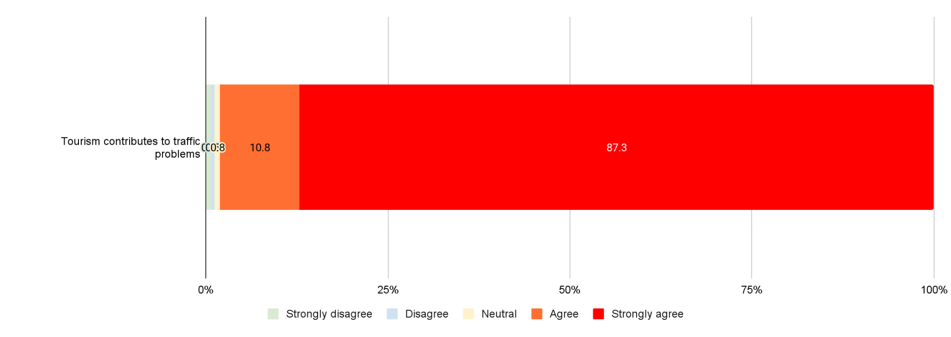
98% of respondents agree or strongly agree with the statement that tourism contributes to traffic problems
N=3,897

Slide 50
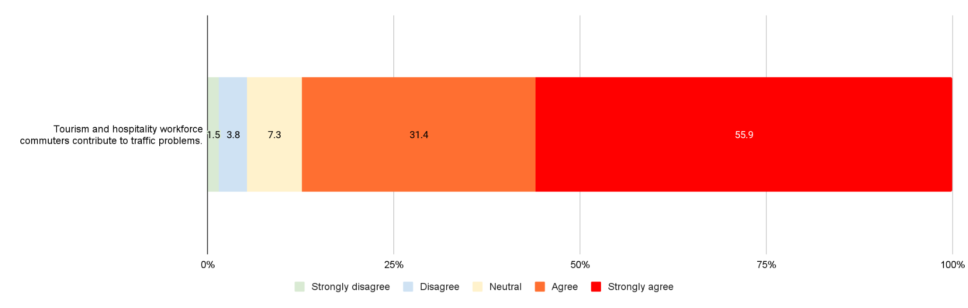
87% of respondents feel that tourism and workforce commuters contribute to the traffic problems
N=3,899

Slide 51
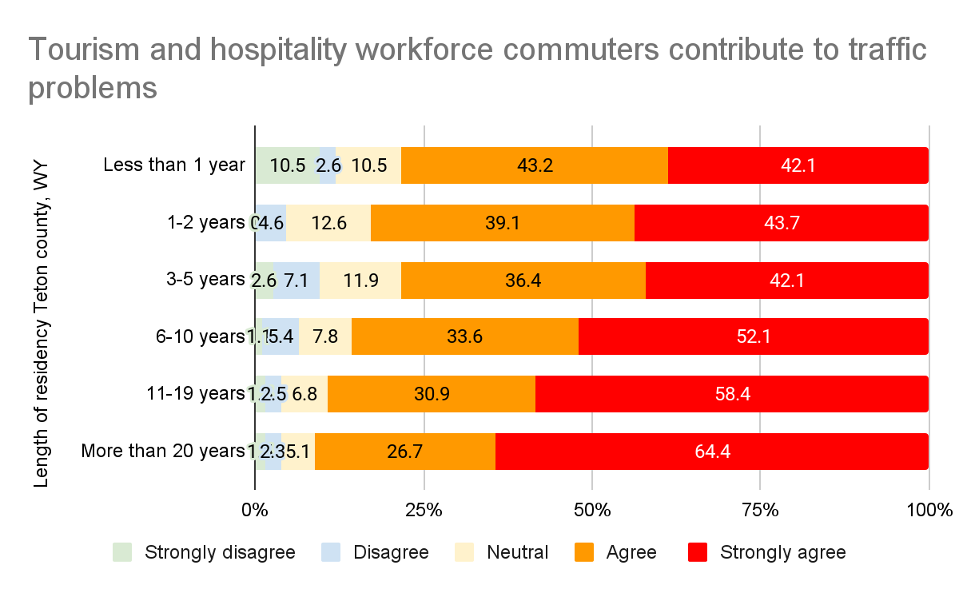
Respondents that have lived in the county longer, are more likely to state that the tourism workforce contributes to the traffic problems
N=3,061

Slide 52
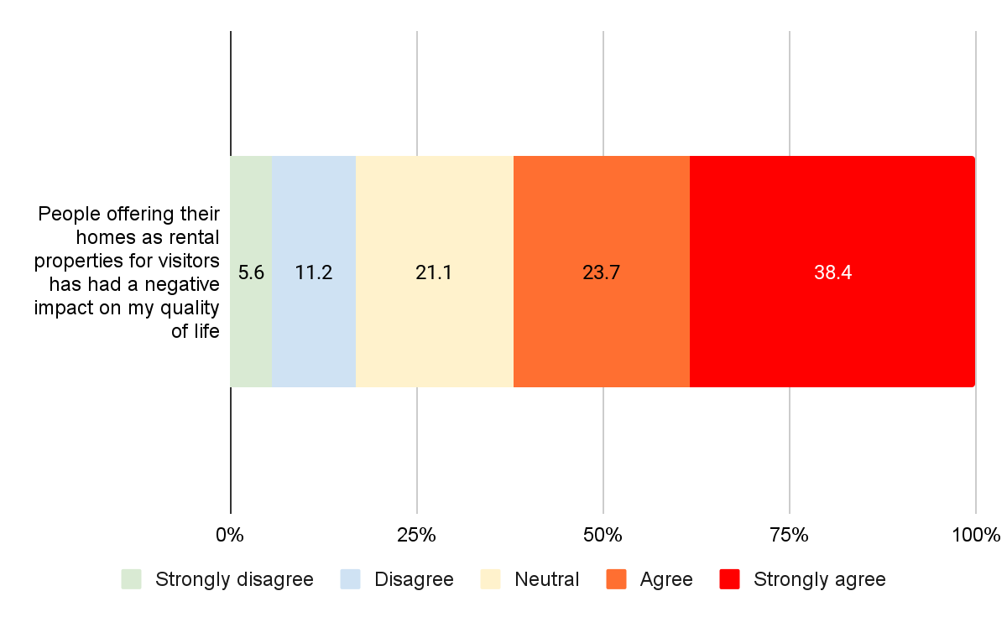
62% of respondents agree or strongly agree to the statement that people offering their homes as rental properties negatively impacts their quality of life
N=3,897

Slide 53
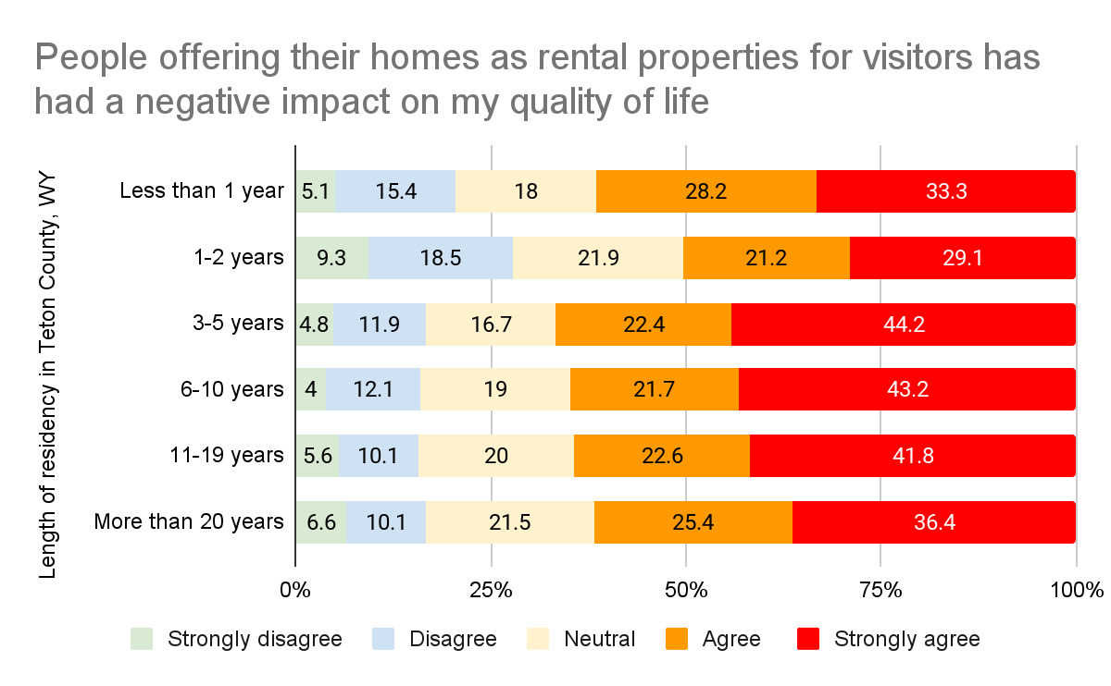
Respondents who have lived in the county 3-19 years feel more strongly about rental properties having a negative impact on their life
N=3,061

Slide 54
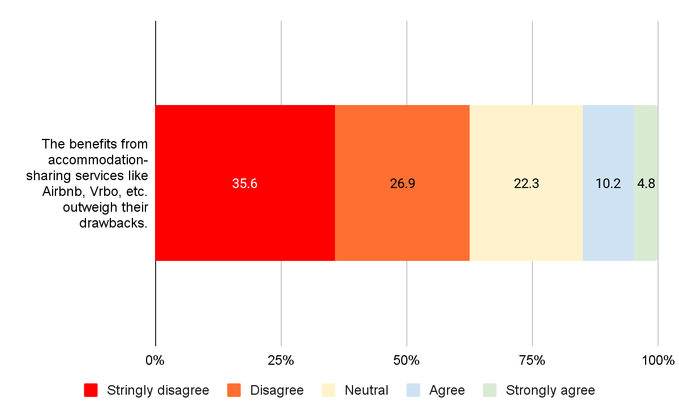
63% of respondents disagree or strongly disagree that the benefits of accommodation sharing services outweigh their drawbacks
N=3,897

Slide 55

Respondents who have lived in the county 3-19 years are more likely to disagree with the statement that the benefits accommodation-sharing services outweighing the drawbacks
N=3,061

Slide 56

75% of respondents strongly agree that the number of people visiting the county in summer impacts their quality of life
N=3,893

Slide 57

66% of respondents who have been living in the county for more than 20 years, agree or strongly agree number of people visiting the county in winter impacts their quality of life
N=3,059

Slide 58

51% of respondents who have been living in the county for more than 20 years, agree or strongly agree that the number of people visiting the county in spring impacts their quality of life
N=3,059

Slide 59

95% of respondents who have been living in the county for more than 20 years, agree or strongly agree number of people visiting the county in summer impacts their quality of life
N=3,059

Slide 60

71% of respondents who have been living in the county for more than 20 years, agree or strongly agree that the number of people visiting the county in fall impacts their quality of life
N=3,059

Slide 61

84% of respondents strongly agree that in summer attractions are becoming overcrowded due to the number of visitors
N=3,899

Slide 62

79% of respondents who have been living in the county for more than 20 years, agree or strongly agree that in winter attractions are becoming overcrowded due to the number of visitors
N=3,058

Slide 63

59% of respondents who have been living in the county for more than 20 years, agree or strongly agree that in spring attractions are becoming overcrowded due to the number of visitors
N=3,058

Slide 64

97% of respondents who have been living in the county for more than 20 years, agree or strongly agree that in summer attractions are becoming overcrowded due to the number of visitors
N=3,058

Slide 65

77% of respondents who have been living in the county for more than 20 years, agree or strongly agree that in fall attractions are becoming overcrowded due to the number of visitors
N=3,058

Slide 66

73% of respondents feel that the number of visitors affects the demand from residents for recreational opportunities in winter and 85% in summer
N=3,855

Slide 67
Natural Environment

Slide 68

86% of respondents disagree or strongly disagree with the statement that tourism is helping the integrity of the natural environment
N=3,863

Slide 69

Long-time residents are more likely to disagree that tourism helps to maintain the integrity of the natural environment
N=3,052

Slide 70
Frequency of Interaction with Visitors

Slide 71

Interaction with visitors is highest in summer followed by winter and fall
N=3,865

Slide 72
Future of Tourism

Slide 73

92% of respondents state that the county should have less or much less tourism in the summer
N=3,528

Slide 74


65% of respondents who have been living in the county for more than 20 years, state that in winter the county should have less or much less tourism
N=3,043

Slide 75

53% of respondents who have been living in the county for more than 20 years, state that in spring the county should have less or much less tourism
N=3,043

Slide 76

94% of respondents who have been living in the county for more than 20 years, state that in summer the county should have less or much less tourism
N=3,043

Slide 77

73% of respondents who have been living in the county for more than 20 years, state that in fall the county should have less or much less tourism
N=3,043

Slide 78

Ecotourism, scientific/educational and volunteer tourism are preferred over the other segments. Respondents feel least positive about business and sports tourism.
N=3,467

Slide 79

Respondents who have lived in the county less years, are more positive about developing adventure tourism than long-time residents
N=2,983

Slide 80

Respondents who have lived in the county less years, are more positive about developing culinary tourism than long-time residents
N=2,983

Slide 81

Respondents who have lived in the county less years, are more positive about developing ecotourism than long-time residents
N=2,983

Slide 82
Conclusion

Slide 83
Main Takeaways
Visitation has the highest negative impact on the quality of life during summer (93%) followed by fall (61%) and winter (60%)
Just 26% of respondents agree or strongly agree with the statement that the benefits of tourism outweigh its drawbacks in Teton County, Wyoming
61% of agrees or strongly agrees with the statement that they would personally be willing to pay more taxes for local public services if it meant fewer visitors in the area
The longer the respondents have lived in the county, the more dissatisfied they are with the impact of tourism on their quality of life
Respondents with children are slightly less dissatisfied with the impact of tourism on their quality of life than respondents without children
Respondents who work in the tourism sector are less dissatisfied with the impact of tourism on their quality of life than respondents who do not work in the sector
Younger people are more likely to agree with the statement that the benefits of tourism outweigh the drawbacks and they also see themselves benefiting from tourism in an economy and non-economic ways

